Slide 1
Forecasting Google Search Trends
A Replication of M. Varnum’s Research

Slide 2
The Replication
Dataset: US Google Search Terms for “Depression”
Using Machine Learning for Prediction
Methods: ARIMA
Visualising
Stationarize
Plot ACF/PACF and find optimal parameters
Build the ARIMA model
Make predictions
Notes:
ARIMA, short for ‘Auto Regressive Integrated Moving Average’ is actually a class of models that ‘explains’ a given time series based on its own past values, that is, its own lags and the lagged forecast errors
Autocorrelation function, and the PACF for Partial Autocorrelation function. Looking at these two plots together can help us form an idea of what models to fit. Autocorrelation computes and plots the autocorrelations of a time series.

Slide 3
Logic
Data was super clean because very simple
Create a timeseries from the data
Split the dataset (80/20)
Train and test dataset
Predict
Compare test/train prediction to just an autoprediction

Slide 4
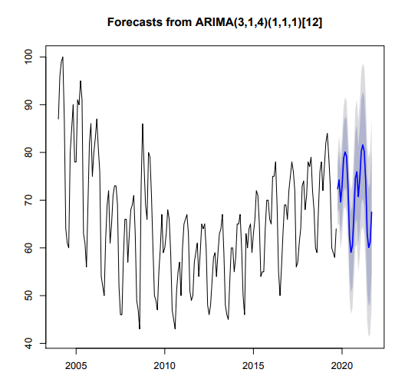
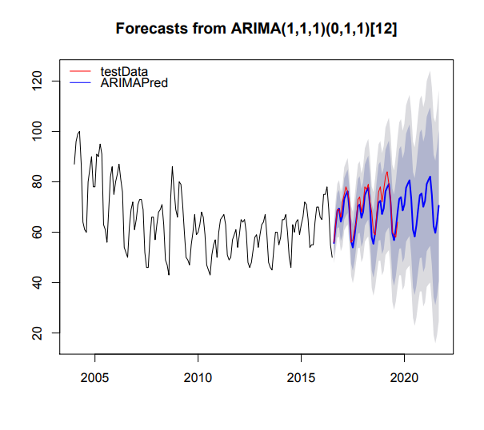
Plots

Slide 5
Why Is This Interesting
The purpose of Big Data utilisation is shifting from monitoring to forecasting
Trend, seasonality, cyclic
Potential uses
Advertising
Government policy
Charity campaigns
Limitations
Basic
Demographics data
Raw data
Notes:
For accurate forecasting, additional analyses such as sentiment will be required.
Diverse sources (ex, SNS) are being analysed together to overcome various limitations
To conduct precise analysis using Big Data, access to raw data should be expanded
Google Search Volume scores are indexed and normalized.
This makes comparisons between forecast future values and observed values somewhat difficult as past values will, can, and often do change from the period in which they were used to construct the forecasts to the present.
However, it should still be possible to heuristically compare patterns from a forecast with actual values observed at a later time point, that is to see if the pattern of the forecast matches the pattern of future data points.

